Slide 1
Optimizing Fitness Class Revenue Using Data-Driven Pricing
Subtitle:
Exploratory Analysis, Demand Forecasting & Dynamic Pricing
Prepared by:
Karan Prakash Ture

Slide 2
Objective:
Fitness classes experience fluctuating demand across time and class types
Static pricing leads to:
  Under-monetization during peak demand
  Low utilization during off-peak hours
Goal:
Maximize revenue per class
Improve overall class occupancy
Align pricing with customer demand

Slide 3
Data Sources:
Historical fitness class booking data (April–June 2018)
Key Variables Used:
Class type
Booking date & time
Price (INR)
Number of bookings
Maximum capacity
Derived Metrics:
Attendance ratio (demand proxy)
Revenue per class

Slide 4
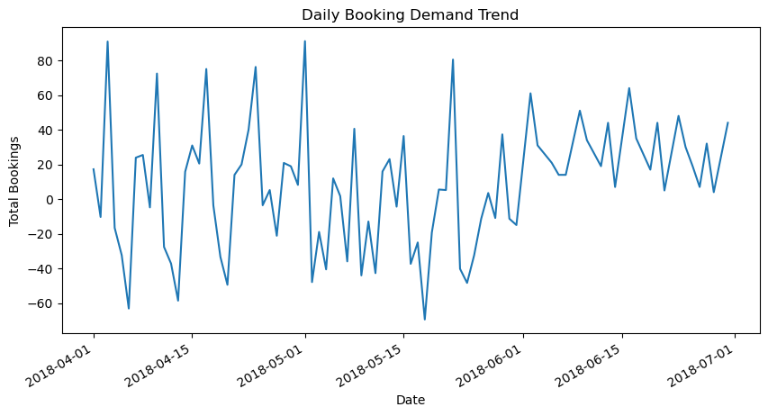
Key Findings:
Certain class types consistently show high booking rates
Demand varies significantly by time and class category
Some classes operate near full capacity while others remain underutilized

Slide 5
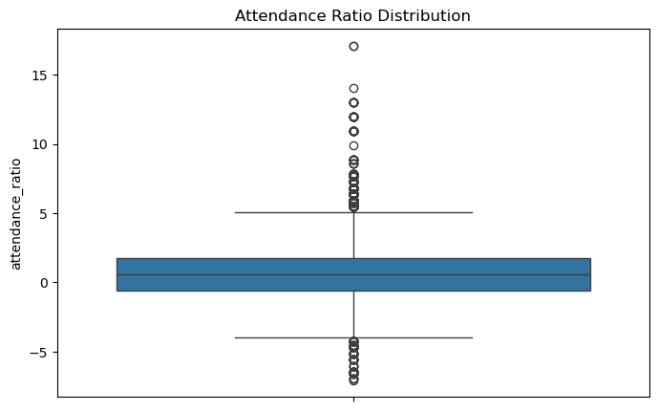
A wide spread in attendance ratios highlights underutilized classes alongside consistently full sessions, revealing opportunities for both discounting and premium pricing.

Slide 6
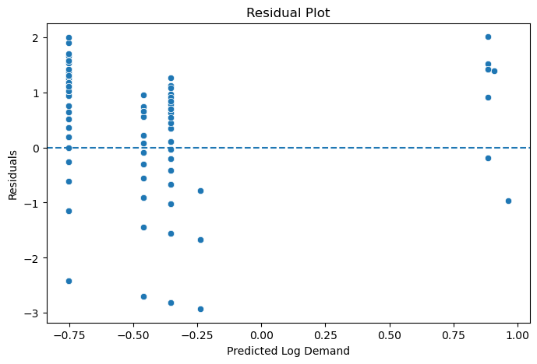
Approach:
Regression-based price elasticity modeling
Studied relationship between price and demand
Insights:
Demand is moderately price sensitive
High-demand classes show lower price sensitivity
Low-demand classes are more price elastic
Implication:
Prices can be increased for high-demand classes without significant loss of bookings

Slide 7
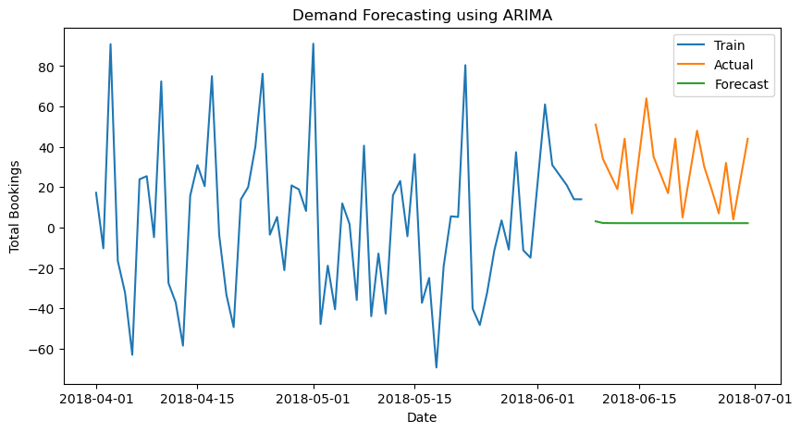
Approach:
Time series forecasting on historical booking data
Key Observations:
Demand patterns show repeatable trends
Peak periods can be anticipated using historical data
Business Value:
Enables proactive pricing decisions
Helps plan class scheduling and capacity allocation

Slide 8
High-Demand Indicators:
Attendance ratio ≥ 80%
Consistently high bookings across weeks
Key Drivers:
Class popularity
Time slots with repeat high occupancy
Customer preferences for specific workout formats
Outcome:
Clear identification of classes suitable for premium pricing
Pricing Logic:
Prices adjusted dynamically based on demand levels
Demand Level | Attendance Ratio | Price Action
High | ≥ 80% | +20%
Medium | 50–79% | +10%
Moderate | 30–49% | No change
Low | < 30% | −15%

Slide 9
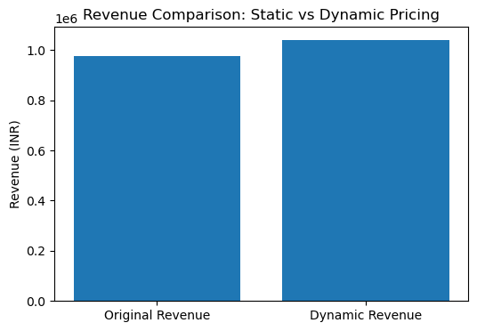
Simulation Approach:
Applied dynamic pricing rules on historical data
Compared static vs dynamic pricing revenue
Results:
Increased revenue during peak demand
Improved utilization for low-demand classes
Overall revenue uplift observed

Slide 10
Business Impact
Revenue Growth:
Better monetization of high-demand classes
Operational Efficiency:
Improved occupancy during off-peak hours
Customer Value:
Fair, demand-based pricing
Incentives for booking low-demand sessions
Risks & Mitigation
Risk | Mitigation
Customer price sensitivity | Gradual price changes
Price perception issues | Transparent communication
Demand volatility | Continuous model updates

Slide 11
Recommendations
Pilot dynamic pricing for selected class categories
Monitor revenue and booking behavior weekly
Introduce price caps to avoid extreme fluctuations
Integrate promotional offers for low-demand periods
Enhance model with location and time-of-day data
Conclusion
Summary:
Data-driven pricing improves both revenue and utilization
Dynamic pricing aligns prices with real customer demand
Scalable solution for long-term business growth
Next Steps:
Expand model using richer datasets
Deploy in real-time booking systems

